Slide 1
Computer Networks: A Systems Approach, 5e
Larry L. Peterson and Bruce S. Davie
Chapter 3
Internetworking
Copyright © 2010, Elsevier Inc. All rights Reserved
Notes:
The University of Adelaide, School of Computer Science
Chapter 2 — Instructions: Language of the Computer

Slide 2
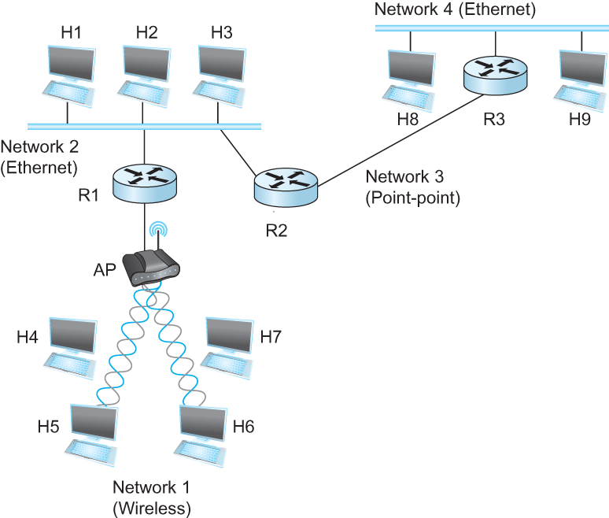
Internetworking
What is internetwork
  An arbitrary collection of networks interconnected to provide some sort of host-host to packet delivery service
  A simple internetwork where H represents hosts and R represents routers
Notes:
The University of Adelaide, School of Computer Science
Chapter 2 — Instructions: Language of the Computer

Slide 3
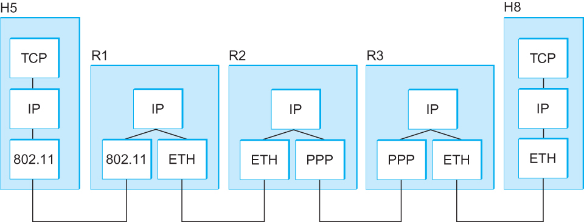
Internetworking
What is IP
  IP stands for Internet Protocol
  Key tool used today to build scalable, heterogeneous internetworks
  It runs on all the nodes in a collection of networks and defines the infrastructure that allows these nodes and networks to function as a single logical internetwork
  A simple internetwork showing the protocol layers
Notes:
The University of Adelaide, School of Computer Science
Chapter 2 — Instructions: Language of the Computer

Slide 4
IP Service Model
Packet Delivery Model
  Connectionless model for data delivery
  Best-effort delivery (unreliable service)
    packets are lost
    packets are delivered out of order
    duplicate copies of a packet are delivered
    packets can be delayed for a long time
Global Addressing Scheme
  Provides a way to identify all hosts in the network
Notes:
The University of Adelaide, School of Computer Science
Chapter 2 — Instructions: Language of the Computer

Slide 5
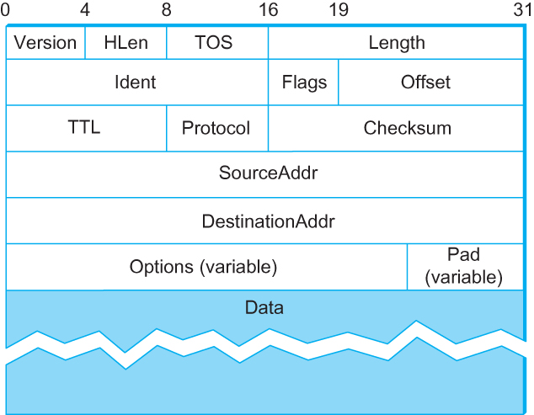
Packet Format
  Version (4): currently 4
  Hlen (4): number of 32-bit words in header
  TOS (8): type of service (not widely used)
  Length (16): number of bytes in this datagram
  Ident (16): used by fragmentation
  Flags/Offset (16): used by fragmentation
  TTL (8): number of hops this datagram has traveled
  Protocol (8): demux key (TCP=6, UDP=17)
  Checksum (16): of the header only
  DestAddr & SrcAddr (32)
Notes:
The University of Adelaide, School of Computer Science
Chapter 2 — Instructions: Language of the Computer

Slide 6
IP Fragmentation and Reassembly
Each network has some MTU (Maximum Transmission Unit)
  Ethernet (1500 bytes), FDDI (4500 bytes)
Strategy
  Fragmentation occurs in a router when it receives a datagram that it wants to forward over a network which has (MTU < datagram)
  Reassembly is done at the receiving host
  All the fragments carry the same identifier in the Ident field
  Fragments are self-contained datagrams
  IP does not recover from missing fragments
Notes:
The University of Adelaide, School of Computer Science
Chapter 2 — Instructions: Language of the Computer

Slide 7
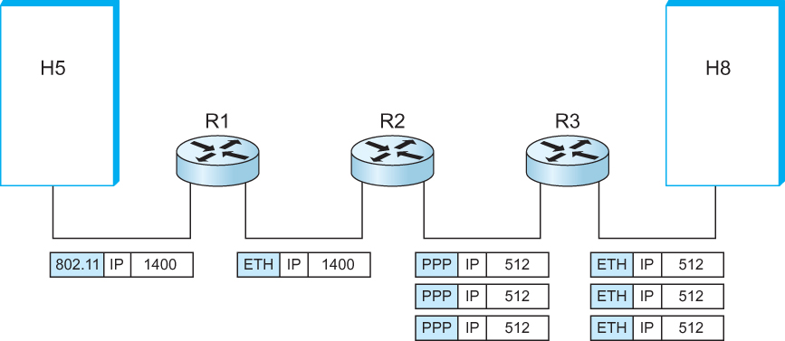
IP Fragmentation and Reassembly
  IP datagrams traversing the sequence of physical networks
Notes:
The University of Adelaide, School of Computer Science
Chapter 2 — Instructions: Language of the Computer

Slide 8
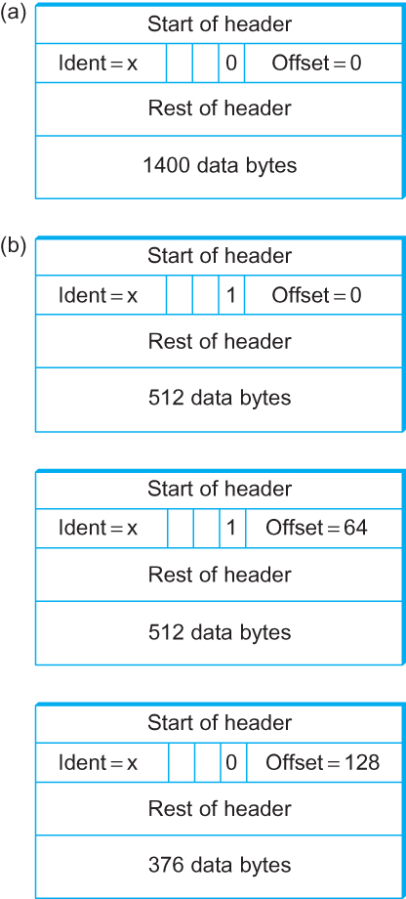
IP Fragmentation and Reassembly
Header fields used in IP fragmentation. (a) Unfragmented packet; (b) fragmented packets.
Notes:
The University of Adelaide, School of Computer Science
Chapter 2 — Instructions: Language of the Computer

Slide 9
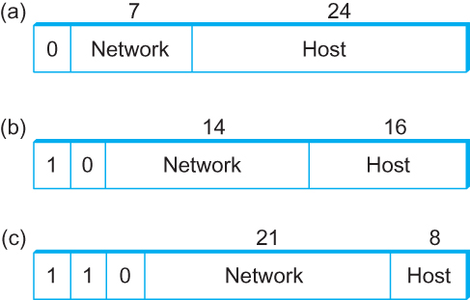
Global Addresses
Properties
  globally unique
  hierarchical: network + host
  4 Billion IP address, half are A type, ¼ is B type, and 1/8 is C type
Format
Dot notation
  10.3.2.4
  128.96.33.81
  192.12.69.77
Notes:
The University of Adelaide, School of Computer Science
Chapter 2 — Instructions: Language of the Computer

Slide 10
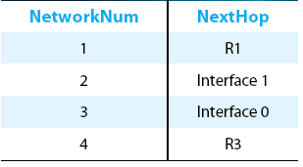
IP Datagram Forwarding
Strategy
  every datagram contains destination's address
  if directly connected to destination network, then forward to host
  if not directly connected to destination network, then forward to some router
  forwarding table maps network number into next hop
  each host has a default router
  each router maintains a forwarding table
Example (router R2)
Notes:
The University of Adelaide, School of Computer Science
Chapter 2 — Instructions: Language of the Computer

Slide 11
IP Datagram Forwarding
Algorithm
if (NetworkNum of destination = NetworkNum of one of my interfaces) then
deliver packet to destination over that interface
else
if (NetworkNum of destination is in my forwarding table) then
deliver packet to NextHop router
else
deliver packet to default router
For a host with only one interface and only a default router in its forwarding table, this simplifies to
if (NetworkNum of destination = my NetworkNum)then
deliver packet to destination directly
else
deliver packet to default router
Notes:
The University of Adelaide, School of Computer Science
Chapter 2 — Instructions: Language of the Computer

Slide 12
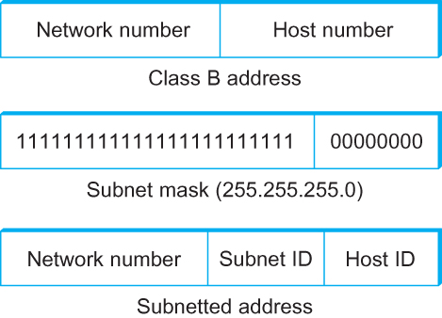
Subnetting
Add another level to address/routing hierarchy: subnet
Subnet masks define variable partition of host part of class A and B addresses
Subnets visible only within site
Notes:
The University of Adelaide, School of Computer Science
Chapter 2 — Instructions: Language of the Computer

Slide 13
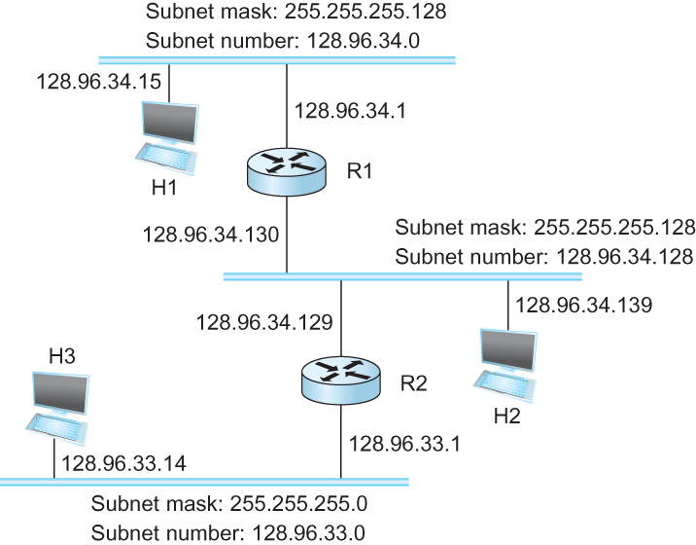
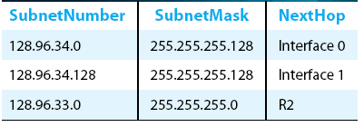
Subnetting
Forwarding Table at Router R1
Notes:
The University of Adelaide, School of Computer Science
Chapter 2 — Instructions: Language of the Computer

Slide 14
Subnetting
Forwarding Algorithm
D = destination IP address
for each entry < SubnetNum, SubnetMask, NextHop>
  D1 = SubnetMask & D
  if D1 = SubnetNum
    if NextHop is an interface
    deliver datagram directly to destination
    else
    deliver datagram to NextHop (a router)
Notes:
The University of Adelaide, School of Computer Science
Chapter 2 — Instructions: Language of the Computer

Slide 15
Subnetting
Notes
Would use a default router if nothing matches
Not necessary for all ones in subnet mask to be contiguous
Can put multiple subnets on one physical network
Subnets not visible from the rest of the Internet
Notes:
The University of Adelaide, School of Computer Science
Chapter 2 — Instructions: Language of the Computer

Slide 16
Classless Addressing
Classless Inter-Domain Routing
  A technique that addresses two scaling concerns in the Internet
    The growth of backbone routing table as more and more network numbers need to be stored in them
    Potential exhaustion of the 32-bit address space
  Address assignment efficiency
    Arises because of the IP address structure with class A, B, and C addresses
    Forces us to hand out network address space in fixed-size chunks of three very different sizes
      A network with two hosts needs a class C address
        Address assignment efficiency = 2/255 = 0.78
      A network with 256 hosts needs a class B address
        Address assignment efficiency = 256/65535 = 0.39
Notes:
The University of Adelaide, School of Computer Science
Chapter 2 — Instructions: Language of the Computer

Slide 17
Classless Addressing
Exhaustion of IP address space centers on exhaustion of the class B network numbers
Solution
  Say “NO” to any Autonomous System (AS) that requests a class B address unless they can show a need for something close to 64K addresses
  Instead give them an appropriate number of class C addresses
  For any AS with at least 256 hosts, we can guarantee an address space utilization of at least 50%
What is the problem with this solution?
Notes:
The University of Adelaide, School of Computer Science
Chapter 2 — Instructions: Language of the Computer

Slide 18
Classless Addressing
Problem with this solution
  Excessive storage requirement at the routers.
If a single AS has, say 16 class C network numbers assigned to it,
  Every Internet backbone router needs 16 entries in its routing tables for that AS
  This is true, even if the path to every one of these networks is the same
If we had assigned a class B address to the AS
  The same routing information can be stored in one entry
  Efficiency = 16 × 255 / 65, 536 = 6.2%
Notes:
The University of Adelaide, School of Computer Science
Chapter 2 — Instructions: Language of the Computer

Slide 19
Classless Addressing
CIDR tries to balance the desire to minimize the number of routes that a router needs to know against the need to hand out addresses efficiently.
CIDR uses aggregate routes
  Uses a single entry in the forwarding table to tell the router how to reach a lot of different networks
  Breaks the rigid boundaries between address classes
Notes:
The University of Adelaide, School of Computer Science
Chapter 2 — Instructions: Language of the Computer

Slide 20
Classless Addressing
Consider an AS with 16 class C network numbers.
Instead of handing out 16 addresses at random, hand out a block of contiguous class C addresses
Suppose we assign the class C network numbers from 192.4.16 through 192.4.31
Observe that top 20 bits of all the addresses in this range are the same (11000000 00000100 0001)
  We have created a 20-bit network number (which is in between class B network number and class C number)
Requires to hand out blocks of class C addresses that share a common prefix
Notes:
The University of Adelaide, School of Computer Science
Chapter 2 — Instructions: Language of the Computer

Slide 21
Classless Addressing
Requires to hand out blocks of class C addresses that share a common prefix
The convention is to place a /X after the prefix where X is the prefix length in bits
For example, the 20-bit prefix for all the networks 192.4.16 through 192.4.31 is represented as 192.4.16/20
By contrast, if we wanted to represent a single class C network number, which is 24 bits long, we would write it 192.4.16/24
Notes:
The University of Adelaide, School of Computer Science
Chapter 2 — Instructions: Language of the Computer

Slide 22
Classless Addressing
How do the routing protocols handle this classless addresses
  It must understand that the network number may be of any length
Represent network number with a single pair
    <length, value>
All routers must understand CIDR addressing
Notes:
The University of Adelaide, School of Computer Science
Chapter 2 — Instructions: Language of the Computer

Slide 23
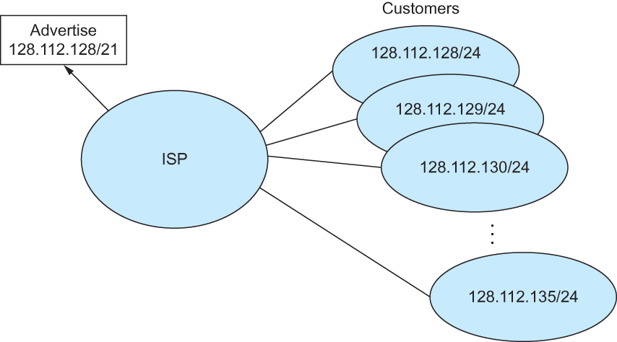
Classless Addressing
Route aggregation with CIDR
Notes:
The University of Adelaide, School of Computer Science
Chapter 2 — Instructions: Language of the Computer

Slide 24
IP Forwarding Revisited
IP forwarding mechanism assumes that it can find the network number in a packet and then look up that number in the forwarding table
We need to change this assumption in case of CIDR
CIDR means that prefixes may be of any length, from 2 to 32 bits
Notes:
The University of Adelaide, School of Computer Science
Chapter 2 — Instructions: Language of the Computer

Slide 25
IP Forwarding Revisited
It is also possible to have prefixes in the forwarding tables that overlap
  Some addresses may match more than one prefix
For example, we might find both 171.69 (a 16 bit prefix) and 171.69.10 (a 24 bit prefix) in the forwarding table of a single router
A packet destined to 171.69.10.5 clearly matches both prefixes.
  The rule is based on the principle of “longest match”
    171.69.10 in this case
A packet destined to 171.69.20.5 would match 171.69 and not 171.69.10
Notes:
The University of Adelaide, School of Computer Science
Chapter 2 — Instructions: Language of the Computer

Slide 26
Address Translation Protocol (ARP)
Map IP addresses into physical addresses
  destination host
  next hop router
Techniques
  encode physical address in host part of IP address
  table-based
ARP (Address Resolution Protocol)
  table of IP to physical address bindings
  broadcast request if IP address not in table
  target machine responds with its physical address
  table entries are discarded if not refreshed
Notes:
The University of Adelaide, School of Computer Science
Chapter 2 — Instructions: Language of the Computer

Slide 27
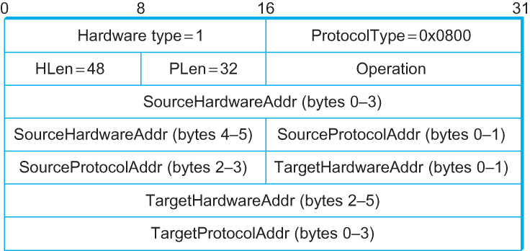
ARP Packet Format
  HardwareType: type of physical network (e.g., Ethernet)
  ProtocolType: type of higher layer protocol (e.g., IP)
  HLEN & PLEN: length of physical and protocol addresses
  Operation: request or response
  Source/Target Physical/Protocol addresses
Notes:
The University of Adelaide, School of Computer Science
Chapter 2 — Instructions: Language of the Computer

Slide 28
Host Configurations
Notes
  Ethernet addresses are configured into network by manufacturer and they are unique
  IP addresses must be unique on a given internetwork but also must reflect the structure of the internetwork
  Most host Operating Systems provide a way to manually configure the IP information for the host
  Drawbacks of manual configuration
    A lot of work to configure all the hosts in a large network
    Configuration process is error-prune
  Automated Configuration Process is required
Notes:
The University of Adelaide, School of Computer Science
Chapter 2 — Instructions: Language of the Computer

Slide 29
Dynamic Host Configuration Protocol (DHCP)
DHCP server is responsible for providing configuration information to hosts
There is at least one DHCP server for an administrative domain
DHCP server maintains a pool of available addresses
Notes:
The University of Adelaide, School of Computer Science
Chapter 2 — Instructions: Language of the Computer

Slide 30
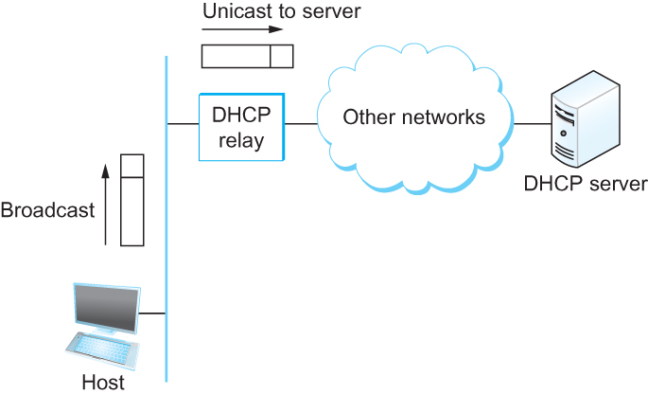
DHCP
Newly booted or attached host sends DHCPDISCOVER message to a special IP address (255.255.255.255)
DHCP relay agent unicasts the message to DHCP server and waits for the response
Notes:
The University of Adelaide, School of Computer Science
Chapter 2 — Instructions: Language of the Computer

Slide 31
Internet Control Message Protocol (ICMP)
Defines a collection of error messages that are sent back to the source host whenever a router or host is unable to process an IP datagram successfully
  Destination host unreachable due to link /node failure
  Reassembly process failed
  TTL had reached 0 (so datagrams don't cycle forever)
  IP header checksum failed
ICMP-Redirect
  From router to a source host
  With a better route information
Notes:
The University of Adelaide, School of Computer Science
Chapter 2 — Instructions: Language of the Computer

Slide 32
Internet Control Message Protocol (ICMP)
Defines a collection of error messages that are sent back to the source host whenever a router or host is unable to process an IP datagram successfully
  Destination host unreachable due to link /node failure
  Reassembly process failed
  TTL had reached 0 (so datagrams don't cycle forever)
  IP header checksum failed
ICMP-Redirect
  From router to a source host
  With a better route information
Notes:
The University of Adelaide, School of Computer Science
Chapter 2 — Instructions: Language of the Computer

Slide 33
Routing
  Forwarding versus Routing
    Forwarding:
      to select an output port based on destination address and routing table
    Routing:
      process by which routing table is built
Notes:
The University of Adelaide, School of Computer Science
Chapter 2 — Instructions: Language of the Computer

Slide 34
Routing
  Forwarding table VS Routing table
    Forwarding table
      Used when a packet is being forwarded and so must contain enough information to accomplish the forwarding function
      A row in the forwarding table contains the mapping from a network number to an outgoing interface and some MAC information, such as Ethernet Address of the next hop
    Routing table
      Built by the routing algorithm as a precursor to build the forwarding table
      Generally contains mapping from network numbers to next hops
Notes:
The University of Adelaide, School of Computer Science
Chapter 2 — Instructions: Language of the Computer

Slide 35
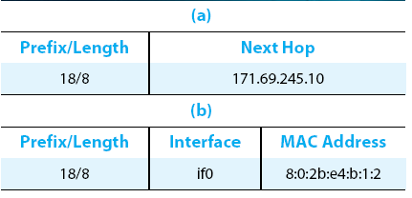
Routing
  Example rows from (a) routing and (b) forwarding tables
Notes:
The University of Adelaide, School of Computer Science
Chapter 2 — Instructions: Language of the Computer

Slide 36
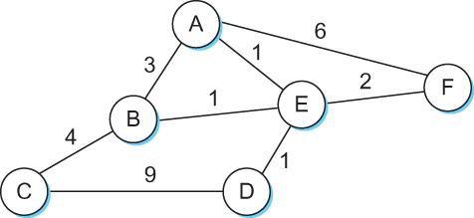
Routing
  Network as a Graph
  The basic problem of routing is to find the lowest-cost path between any two nodes
    Where the cost of a path equals the sum of the costs of all the edges that make up the path
Notes:
The University of Adelaide, School of Computer Science
Chapter 2 — Instructions: Language of the Computer

Slide 37
Routing
  For a simple network, we can calculate all shortest paths and load them into some nonvolatile storage on each node.
  Such a static approach has several shortcomings
    It does not deal with node or link failures
    It does not consider the addition of new nodes or links
    It implies that edge costs cannot change
  What is the solution?
    Need a distributed and dynamic protocol
    Two main classes of protocols
      Distance Vector
      Link State
Notes:
The University of Adelaide, School of Computer Science
Chapter 2 — Instructions: Language of the Computer

Slide 38
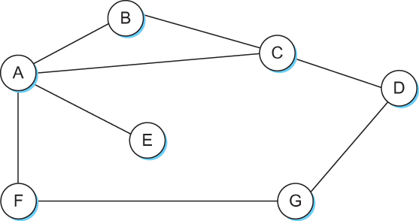
Distance Vector
Each node constructs a one dimensional array (a vector) containing the “distances” (costs) to all other nodes and distributes that vector to its immediate neighbors
Starting assumption is that each node knows the cost of the link to each of its directly connected neighbors
Notes:
The University of Adelaide, School of Computer Science
Chapter 2 — Instructions: Language of the Computer

Slide 39
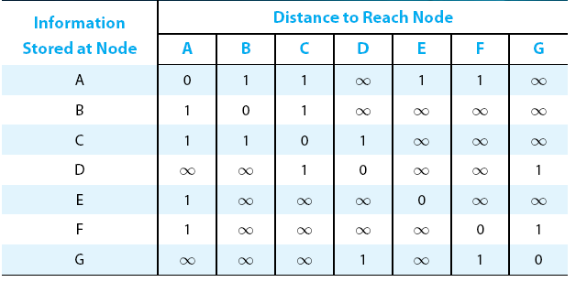
Distance Vector
Initial distances stored at each node (global view)
Notes:
The University of Adelaide, School of Computer Science
Chapter 2 — Instructions: Language of the Computer

Slide 40
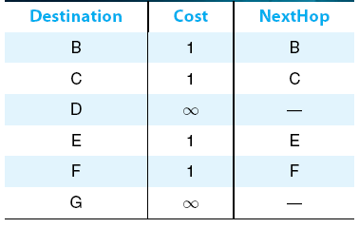
Distance Vector
Initial routing table at node A
Notes:
The University of Adelaide, School of Computer Science
Chapter 2 — Instructions: Language of the Computer

Slide 41
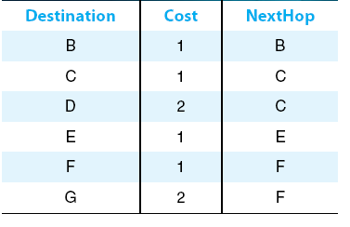
Distance Vector
Final routing table at node A
Notes:
The University of Adelaide, School of Computer Science
Chapter 2 — Instructions: Language of the Computer

Slide 42
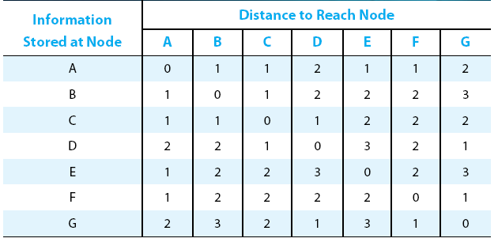
Distance Vector
Final distances stored at each node (global view)
Notes:
The University of Adelaide, School of Computer Science
Chapter 2 — Instructions: Language of the Computer

Slide 43
Distance Vector
The distance vector routing algorithm is sometimes called as Bellman-Ford algorithm
Every T seconds each router sends its table to its neighbor each each router then updates its table based on the new information
Problems include fast response to good new and slow response to bad news. Also too many messages to update
Notes:
The University of Adelaide, School of Computer Science
Chapter 2 — Instructions: Language of the Computer

Slide 44
Distance Vector
  When a node detects a link failure
    F detects that link to G has failed
    F sets distance to G to infinity and sends update to A
    A sets distance to G to infinity since it uses F to reach G
    A receives periodic update from C with 2-hop path to G
    A sets distance to G to 3 and sends update to F
    F decides it can reach G in 4 hops via A
Notes:
The University of Adelaide, School of Computer Science
Chapter 2 — Instructions: Language of the Computer

Slide 45
Distance Vector
Slightly different circumstances can prevent the network from stabilizing
  Suppose the link from A to E goes down
  In the next round of updates, A advertises a distance of infinity to E, but B and C advertise a distance of 2 to E
  Depending on the exact timing of events, the following might happen
    Node B, upon hearing that E can be reached in 2 hops from C, concludes that it can reach E in 3 hops and advertises this to A
    Node A concludes that it can reach E in 4 hops and advertises this to C
    Node C concludes that it can reach E in 5 hops; and so on.
    This cycle stops only when the distances reach some number that is large enough to be considered infinite
      Count-to-infinity problem
Notes:
The University of Adelaide, School of Computer Science
Chapter 2 — Instructions: Language of the Computer

Slide 46
Count-to-infinity Problem
Use some relatively small number as an approximation of infinity
For example, the maximum number of hops to get across a certain network is never going to be more than 16
One technique to improve the time to stabilize routing is called split horizon
  When a node sends a routing update to its neighbors, it does not send those routes it learned from each neighbor back to that neighbor
  For example, if B has the route (E, 2, A) in its table, then it knows it must have learned this route from A, and so whenever B sends a routing update to A, it does not include the route (E, 2) in that update
Notes:
The University of Adelaide, School of Computer Science
Chapter 2 — Instructions: Language of the Computer

Slide 47
Count-to-infinity Problem
In a stronger version of split horizon, called split horizon with poison reverse
  B actually sends that back route to A, but it puts negative information in the route to ensure that A will not eventually use B to get to E
  For example, B sends the route (E, ∞) to A
Notes:
The University of Adelaide, School of Computer Science
Chapter 2 — Instructions: Language of the Computer

Slide 48
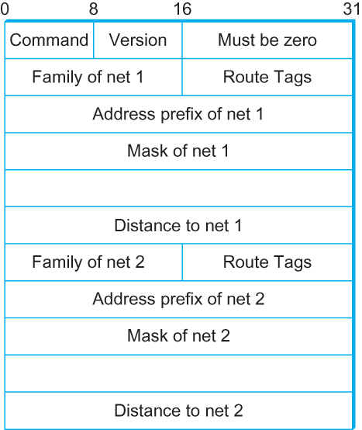
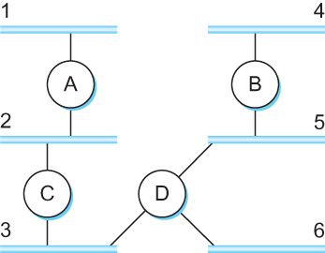
Routing Information Protocol (RIP)
  Example Network
  running RIP RIPv2 Packet Format
Notes:
The University of Adelaide, School of Computer Science
Chapter 2 — Instructions: Language of the Computer

Slide 49
Link State Routing
Strategy: Send to all nodes (not just neighbors) information about directly connected links (not entire routing table).
Link State Packet (LSP)
  id of the node that created the LSP
  cost of link to each directly connected neighbor
  sequence number (SEQNO)
  time-to-live (TTL) for this packet
Reliable Flooding
  store most recent LSP from each node
  forward LSP to all nodes but one that sent it
  generate new LSP periodically; increment SEQNO
  start SEQNO at 0 when reboot
  decrement TTL of each stored LSP; discard when TTL=0
Notes:
The University of Adelaide, School of Computer Science
Chapter 2 — Instructions: Language of the Computer

Slide 50
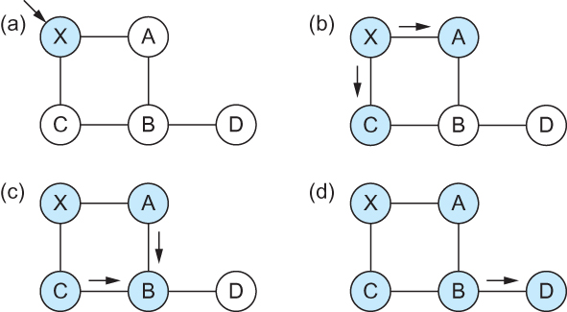
Link State
Reliable Flooding
Flooding of link-state packets. (a) LSP arrives at node X; (b) X floods LSP to A and C; (c) A and C flood LSP to B (but not X); (d) flooding is complete
Notes:
The University of Adelaide, School of Computer Science
Chapter 2 — Instructions: Language of the Computer

Slide 51
Shortest Path Routing
Dijkstra’s Algorithm - Assume non-negative link weights
  N: set of nodes in the graph
  l((i, j): the non-negative cost associated with the edge between nodes i, j ∈N and l(i, j) = ∝ if no edge connects i and j
  Let s ∈N be the starting node which executes the algorithm to find shortest paths to all other nodes in N
  Two variables used by the algorithm
    M: set of nodes incorporated so far by the algorithm
    C(n) : the cost of the path from s to each node n
    The algorithm
      M = {s}
      For each n in N – {s}
        C(n) = l(s, n)
      while ( N ≠ M)
        M = M ∪ {w} such that C(w) is the minimum
        for all w in (N-M)
        For each n in (N-M)
        C(n) = MIN (C(n), C(w) + l(w, n))
Notes:
The University of Adelaide, School of Computer Science
Chapter 2 — Instructions: Language of the Computer

Slide 52
Shortest Path Routing
# Chapter Subtitle
In practice, each switch computes its routing table directly from the LSP’s it has collected using a realization of Dijkstra’s algorithm called the forward search algorithm
Specifically each switch maintains two lists, known as Tentative and Confirmed
Each of these lists contains a set of entries of the form (Destination, Cost, NextHop)
Notes:
The University of Adelaide, School of Computer Science
Chapter 2 — Instructions: Language of the Computer

Slide 53
Shortest Path Routing
The algorithm
  Initialize the Confirmed list with an entry for myself; this entry has a cost of 0
  For the node just added to the Confirmed list in the previous step, call it node Next, select its LSP
  For each neighbor (Neighbor) of Next, calculate the cost (Cost) to reach this Neighbor as the sum of the cost from myself to Next and from Next to Neighbor
    If Neighbor is currently on neither the Confirmed nor the Tentative list, then add (Neighbor, Cost, Nexthop) to the Tentative list, where Nexthop is the direction I go to reach Next
    If Neighbor is currently on the Tentative list, and the Cost is less than the currently listed cost for the Neighbor, then replace the current entry with (Neighbor, Cost, Nexthop) where Nexthop is the direction I go to reach Next
  If the Tentative list is empty, stop. Otherwise, pick the entry from the Tentative list with the lowest cost, move it to the Confirmed list, and return to Step 2.
Notes:
The University of Adelaide, School of Computer Science
Chapter 2 — Instructions: Language of the Computer

Slide 54
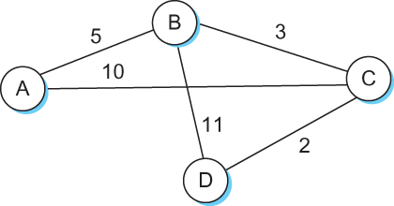
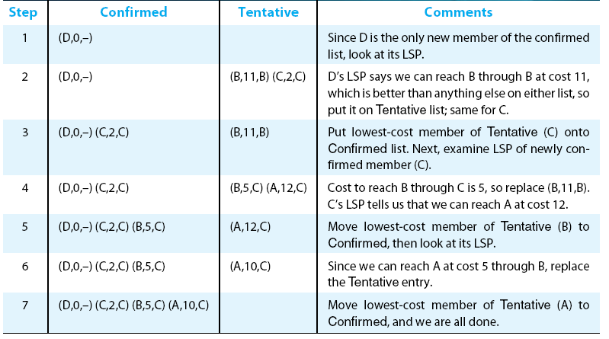
Shortest Path Routing
Notes:
The University of Adelaide, School of Computer Science
Chapter 2 — Instructions: Language of the Computer

Slide 55
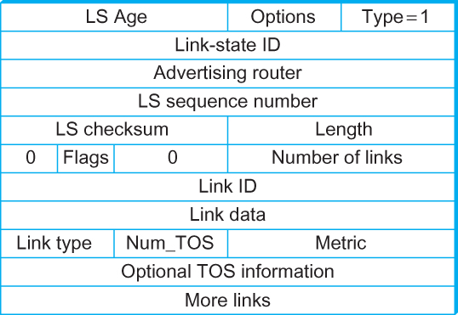
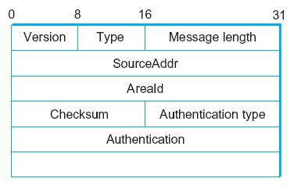
Open Shortest Path First (OSPF)
  OSPF Header Format OSPF Link State Advertisement
Notes:
The University of Adelaide, School of Computer Science
Chapter 2 — Instructions: Language of the Computer

Slide 56
Summary
We have looked at some of the issues involved in building scalable and heterogeneous networks by using switches and routers to interconnect links and networks.
To deal with heterogeneous networks, we have discussed in details the service model of Internetworking Protocol (IP) which forms the basis of today’s routers.
We have discussed in details two major classes of routing algorithms
  Distance Vector
  Link State
Notes:
The University of Adelaide, School of Computer Science
Chapter 2 — Instructions: Language of the Computer

